Slide 1
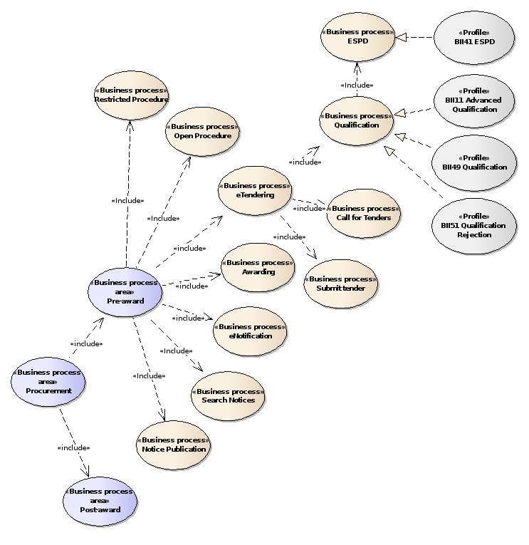

Slide 2
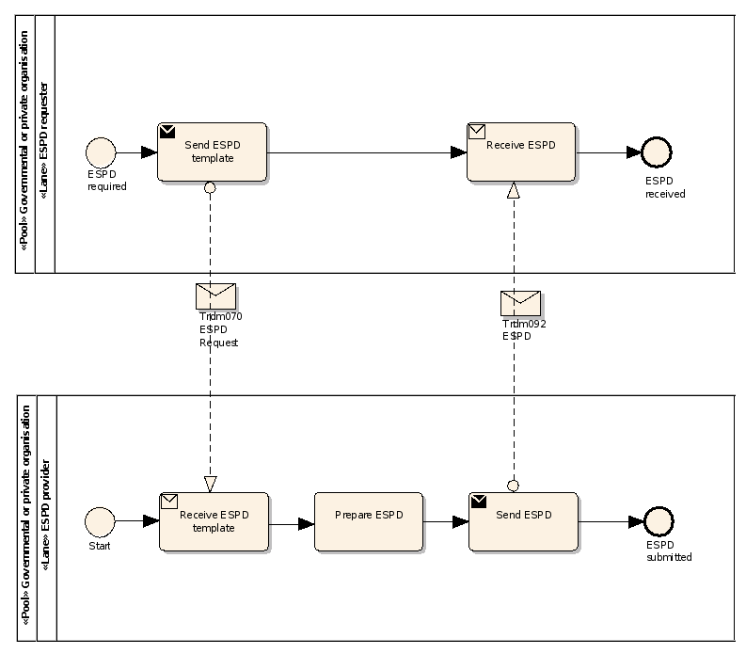
QualificationApplicationRequest
QualificationApplicationResponse

Slide 3
EXCLUSION
CONVICTIONS
PARTICIPATION_IN_CRIMINAL_ORGANISATION, CORRUPTION, FRAUD, TERRORIST_OFFENCES,
MONEY_LAUNDERING, CHILD_LABOUR-HUMAN_TRAFFICKING
CONTRIBUTIONS
PAYMENT_OF_TAXES, PAYMENT_OF_SOCIAL_SECURITY
SOCIAL
ENVIRONMENTAL_LAW, SOCIAL_LAW, LABOUR_LAW
BUSINESS
BANKRUPTCY, INSOLVENCY, CREDITORS_ARRANGEMENT, BANKRUPTCY_ANALOGOUS,
LIQUIDATOR_ADMINISTERED, ACTIVITIES_SUSPENDED
MISCONDUCT
MC_PROFESSIONAL, MARKET_DISTORSION
CONFLICT_OF_INTEREST
PROCEDURE_PARTICIPATION, PROCEDURE_PREPARATION
EARLY_TERMINATION
MISINTERPRETATION
NATIONAL
OTHER

Slide 4
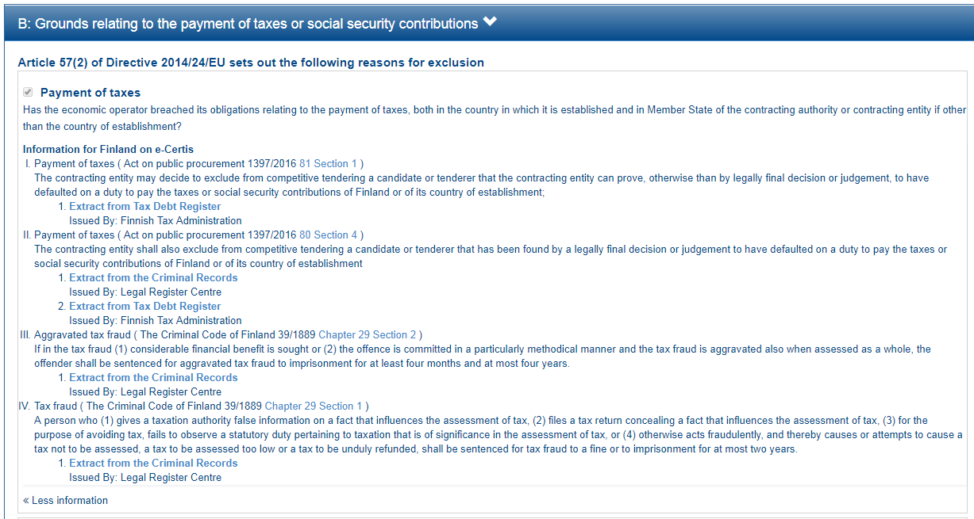

Slide 5
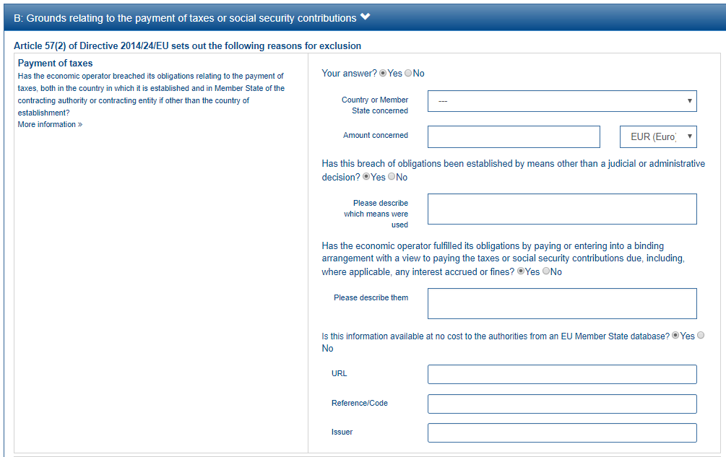
1
2
3
This property is shown only if the answer to the previous QUESTION is ‘Yes’
4
5
6
7
8

Slide 6
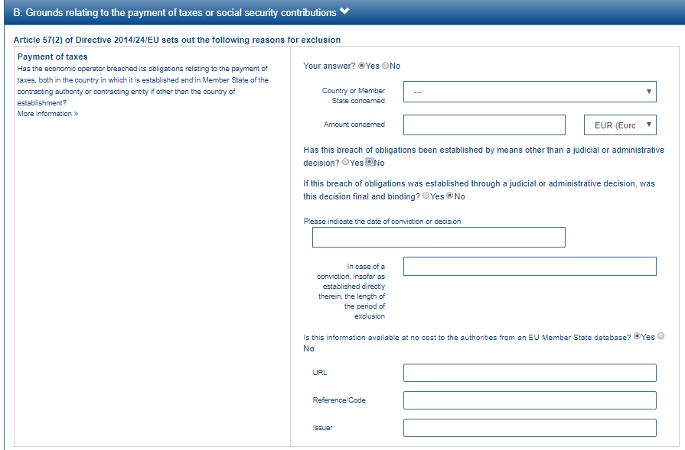
This group of property is shown only if the answer to the previous QUESTION is ‘No’
9
10

Slide 7
EU PoT Criterion
1
FI PoT Criterion I
2
FI PoT Criterion II
3
FI PoT Criterion III
4
FI PoT Criterion IV
5

Slide 8
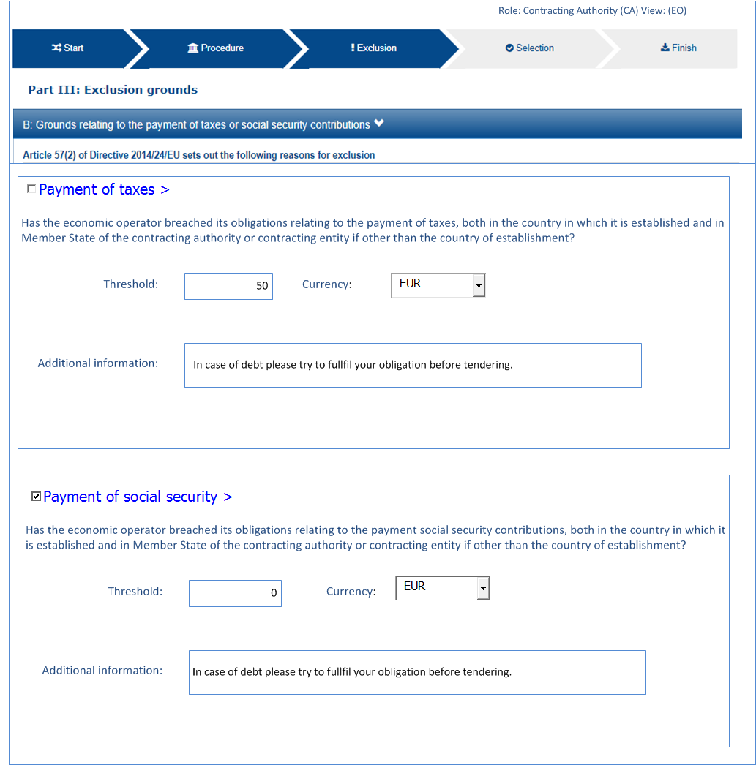
6
7
8

Slide 9
6
7
Minimum threshold: 50€
In case of debt please try to fulfil your obligation before tendering
8

Slide 10
2
3
4
5

Slide 11
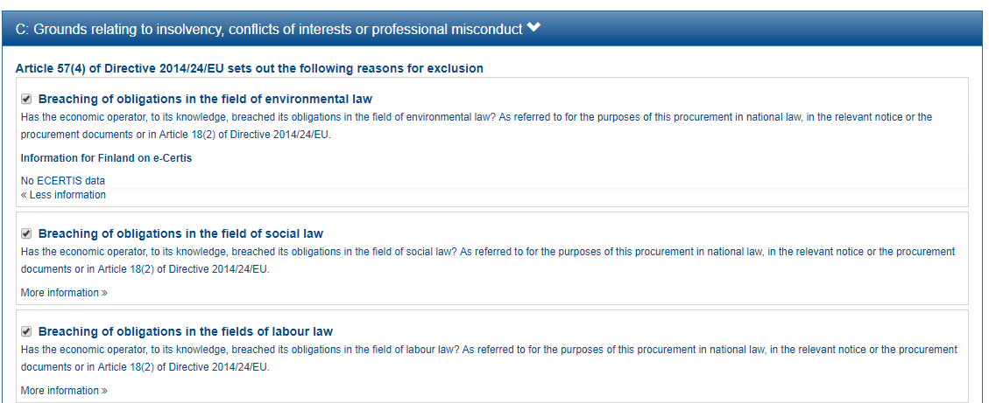

Slide 12
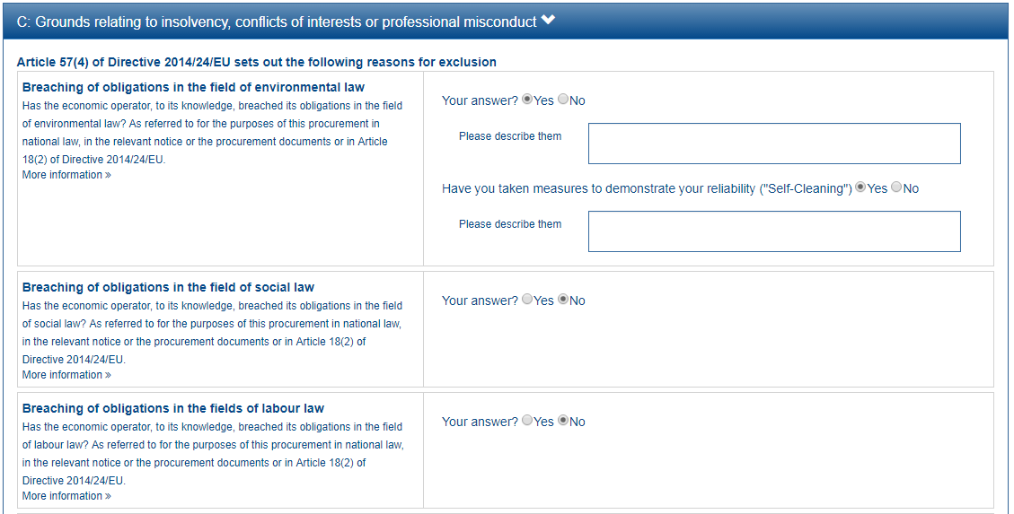
1
2

Slide 13
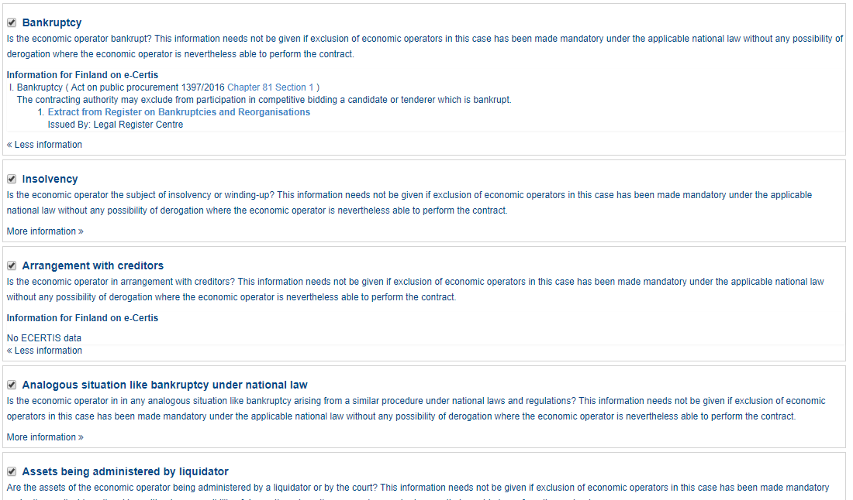

Slide 14
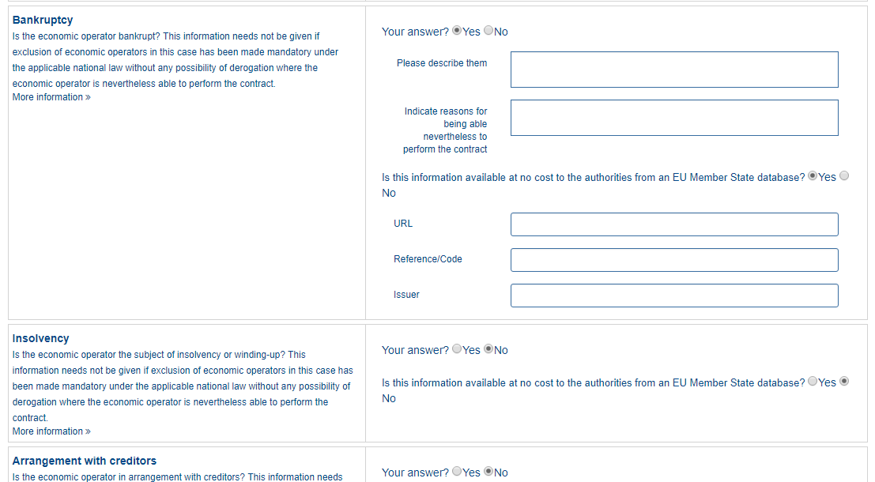
1
2
3
4
5
6

Slide 15
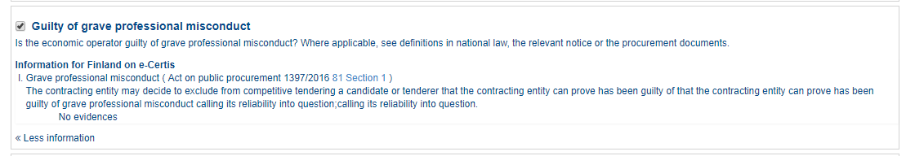

Slide 16
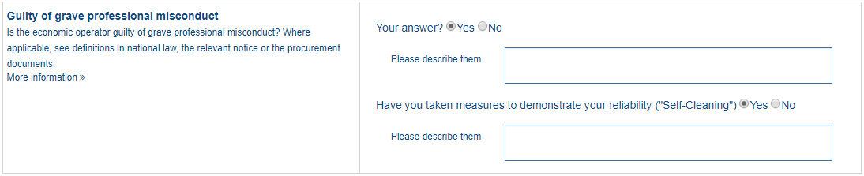
1
2

Slide 17
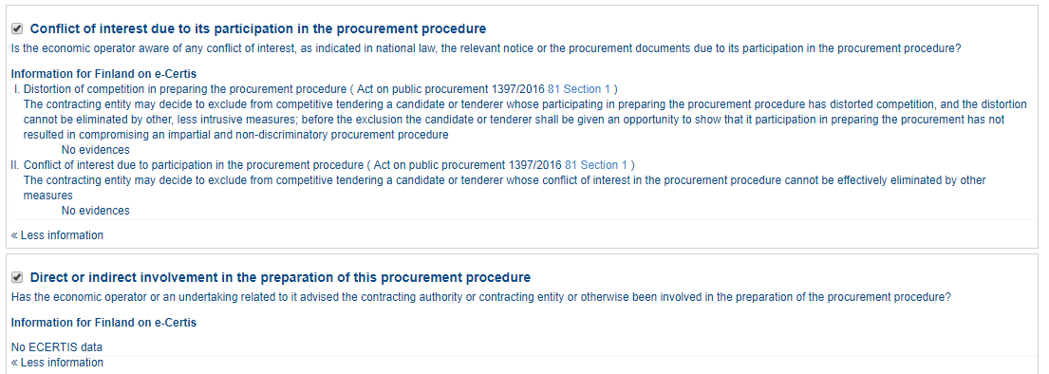

Slide 18
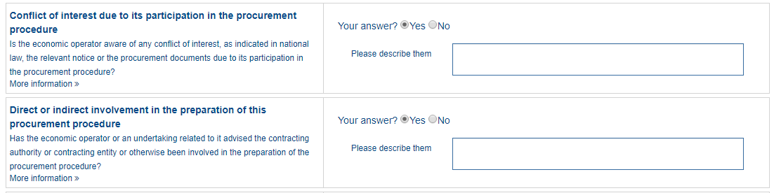
1

Slide 19
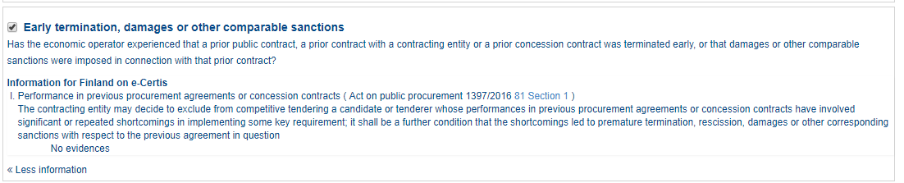

Slide 20
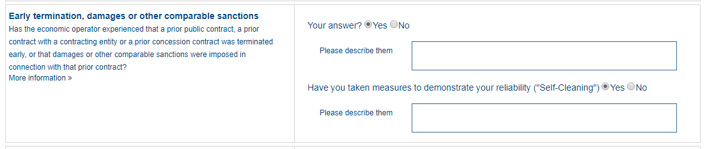
1
2

Slide 21
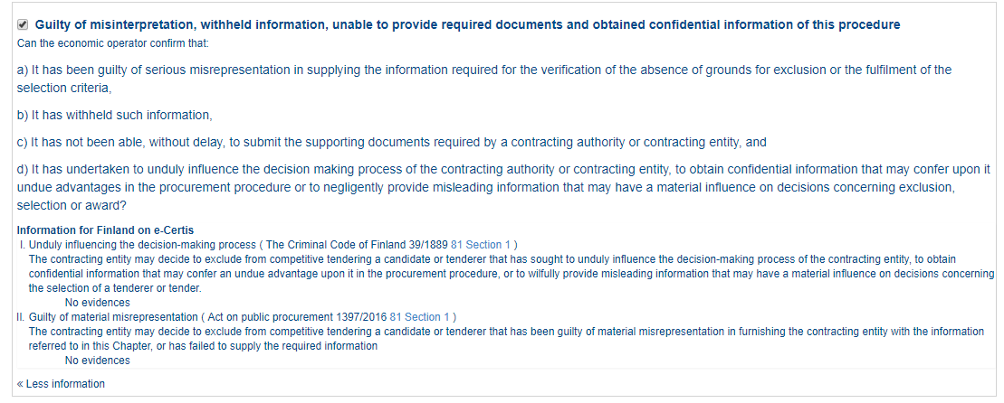

Slide 22
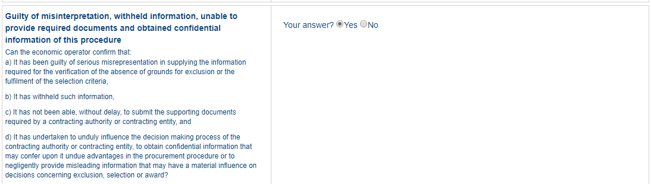
1

Slide 23
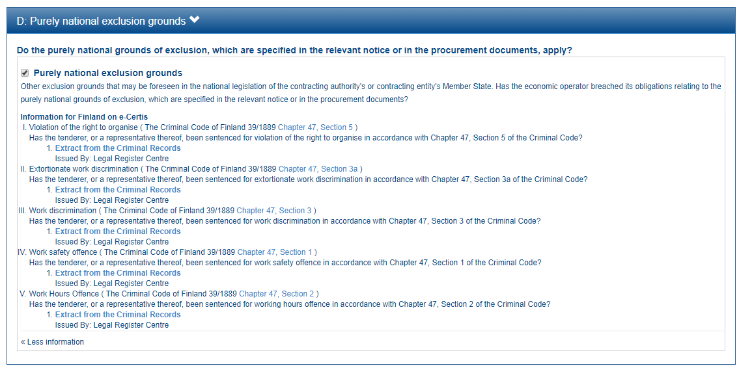

Slide 24
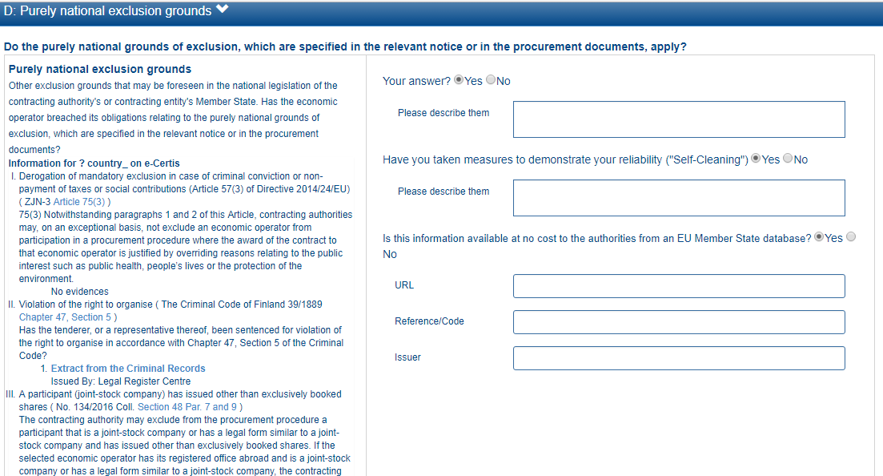
1
2
3
4
5
6

Slide 25
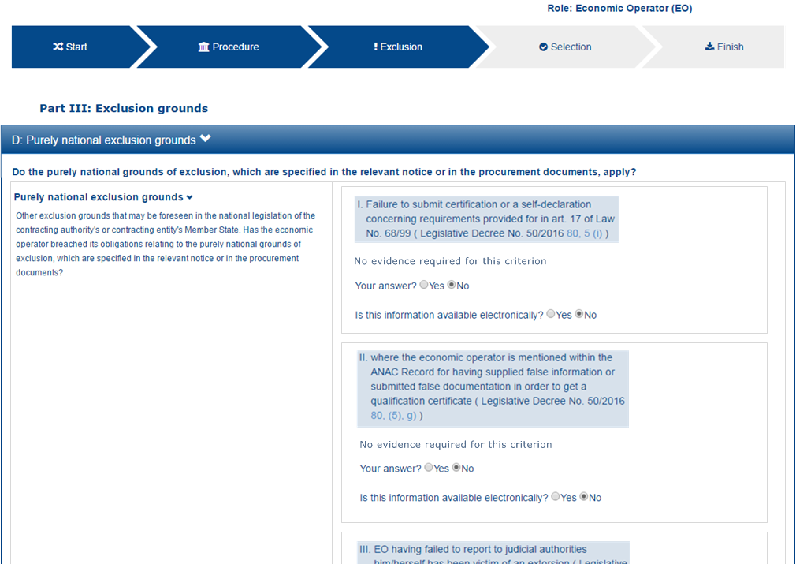
1
2

Slide 26
SELECTION
SUITABILITY
PROFESSIONAL_REGISTER_ENROLMENT, TRADE_REGISTER_ENROLMENT, AUTHORISATION, MEMBERSHIP
ECONOMIC_FINANCIAL_STANDING
TURNOVER
GENERAL_YEARLY
SPECIFIC_YEARLY
AVERAGE_YEARLY
SPECIFIC_AVERAGE
SET_UP
FINANCIAL_RATIO
RISK_INDEMNITY_INSURANCE
OTHER_REQUIREMENTS
TECHNICAL_PROFESSIONAL_ABILITY
REFERENCES
WORKS_PERFORMANCE, SUPPLIES_DELIVERY_PERFORMANCE, SERVICES_DELIVERY_PERFORMANCE
TECHNICAL
TECHNICAL.TECHNICIANS_FOR_QUALITY_CONTROL, TECHNICAL.TECHNICIANS_FOR_CARRYING_WORKS, TECHNICAL.FACILITIES_FOR_QUALITY_ENSURING, TECHNICAL.FACILITIES_FOR_STUDY_RESEARCH,
TECHNICAL.SUPPLY_CHAIN_MANAGEMENT,
TECHNICAL.PROFESSIONAL_QUALIFICATIONS, TECHNICAL.ENVIRONMENTAL_MANAGEMENT_MEASURES,
TECHNICAL.EQUIPMENT
TECHNICAL.CHECKS.ALLOWANCE_OF_CHECKS
MANAGEMENT
MANAGEMENT.MANAGERIAL_STAFF, MANAGEMENT.AVERAGE_ANNUAL_MANPOWER6
MANAGEMENT.SUBCONTRACTING_PROPORTION
MANAGEMENT.ARTEFACTS.NO_AUTHENTICATED_ARTEFACTS
MANAGEMENT.ARTEFACTS.NO_AUTHENTICATED_ARTEFACTS, MANAGEMENT.ARTEFACTS.AUTHENTICATED_ARTEFACTS
CERTIFICATES
QUALITY_ASSURANCE
CERTIFICATES.QUALITY_ASSURANCE.QA_INSTITUTES_CERTIFICATE, CERTIFICATES.QUALITY_ASSURANCE.QA_INDEPENDENT_CERTIFICATE

Slide 27
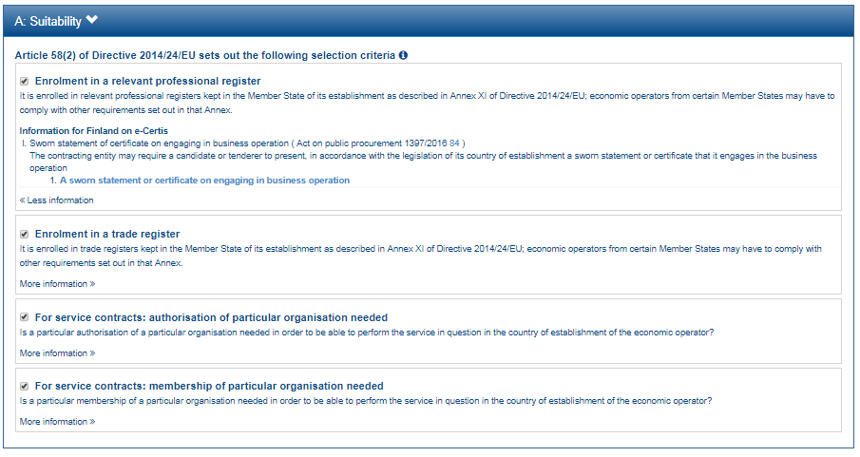

Slide 28
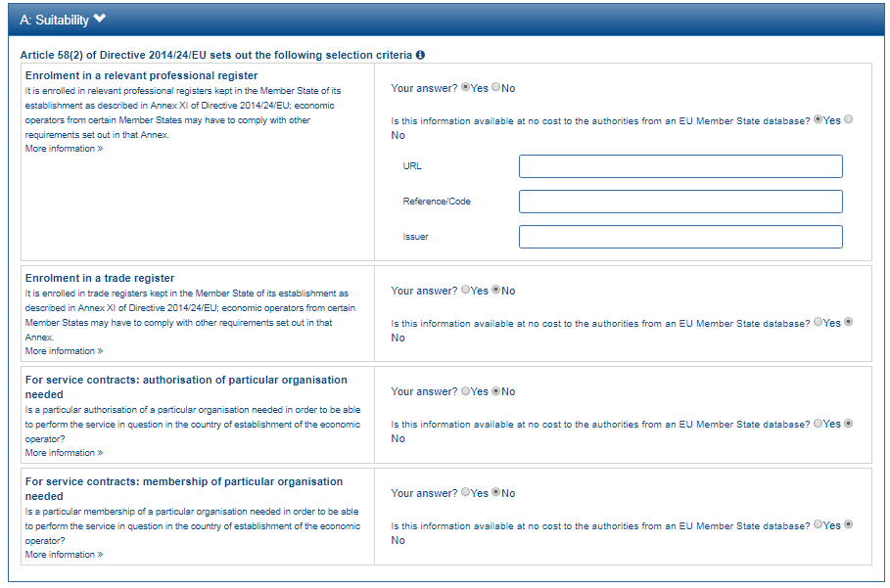
1
2
3
4
5

Slide 29
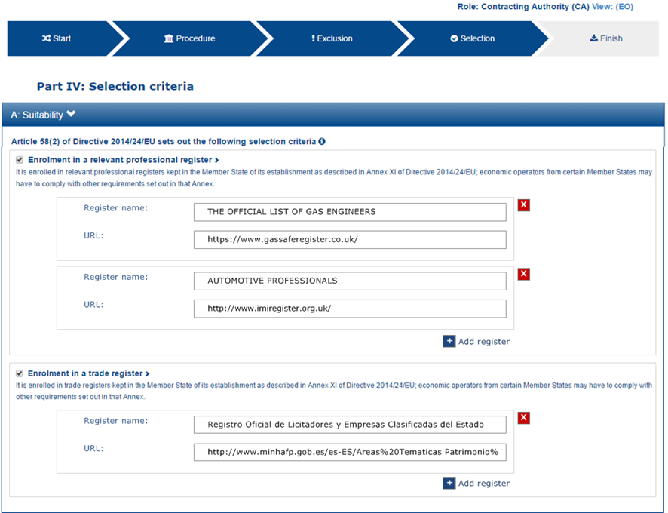

Slide 30
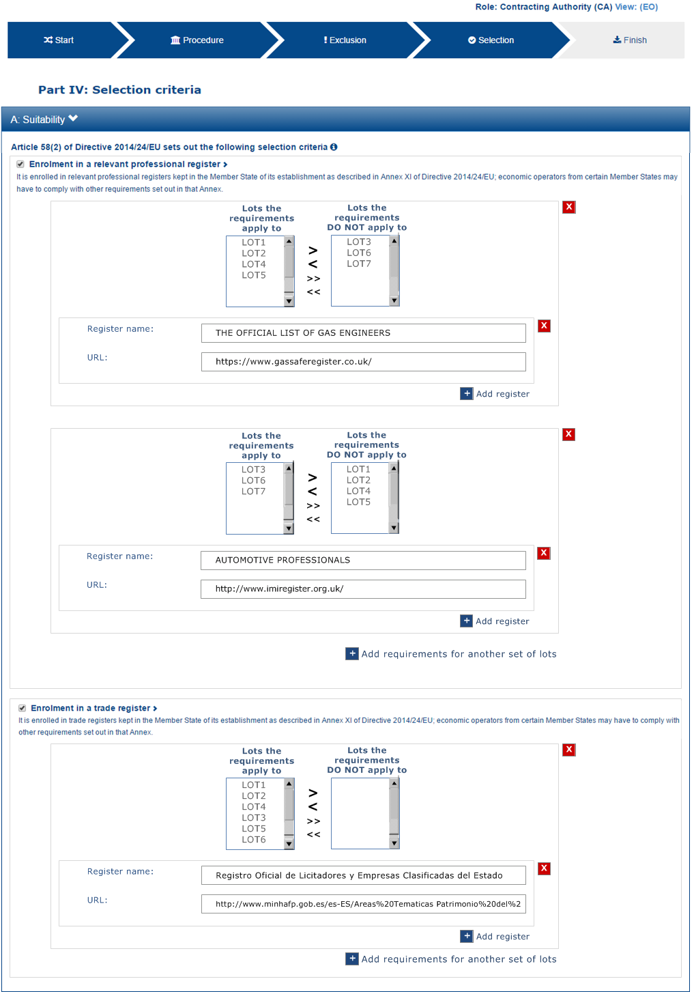
1
2
3

Slide 31
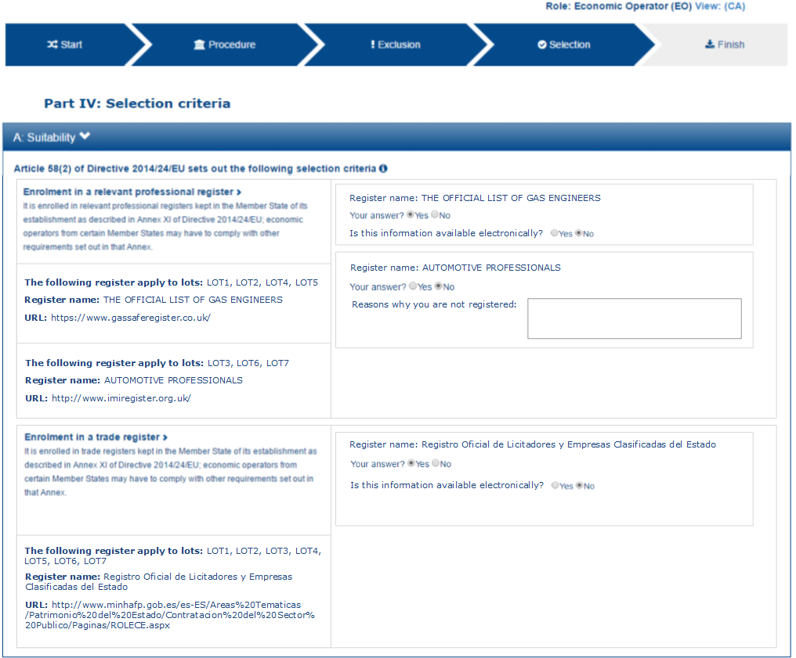
7
8
1
9
2
3
10
4
5
6

Slide 32
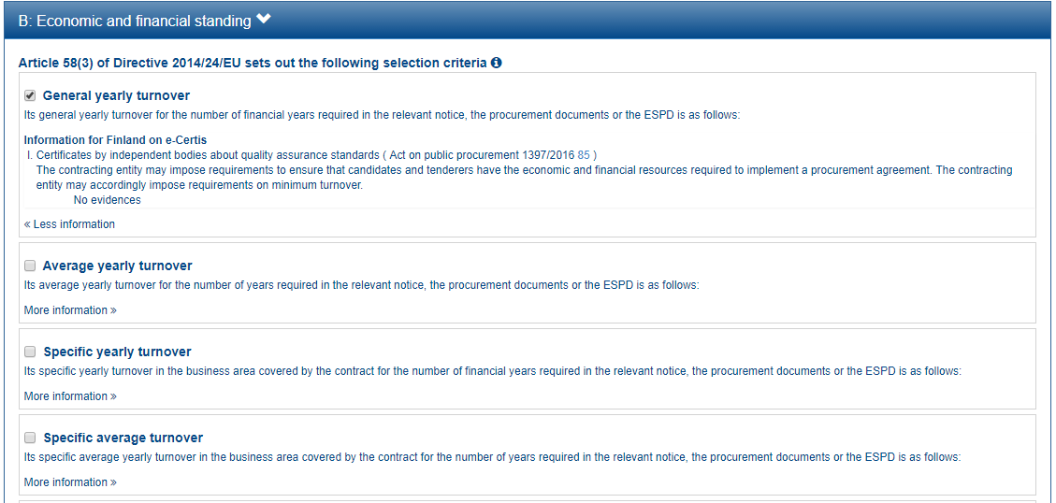
1
2
3

Slide 33
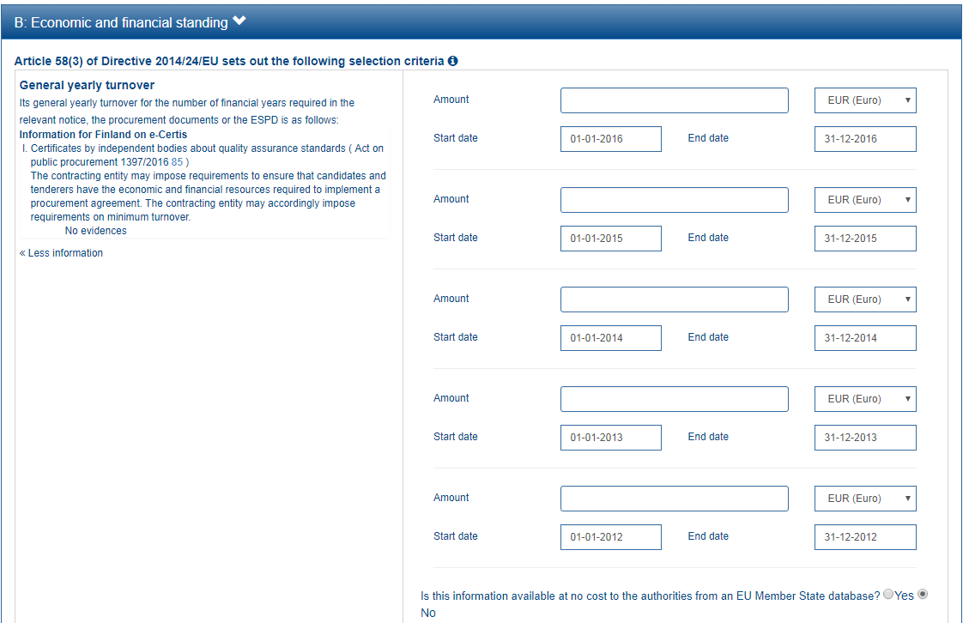
1
4
5
2
6
3
7
8
9
10
11
12
13
14

Slide 34
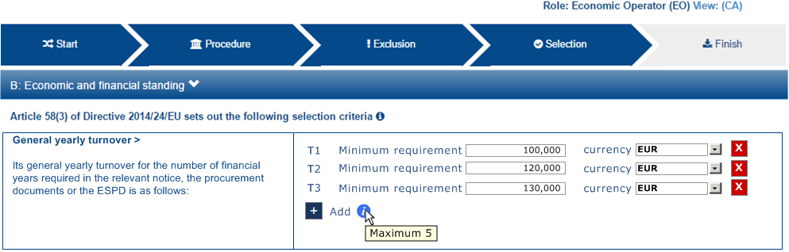
1
2
3

Slide 35
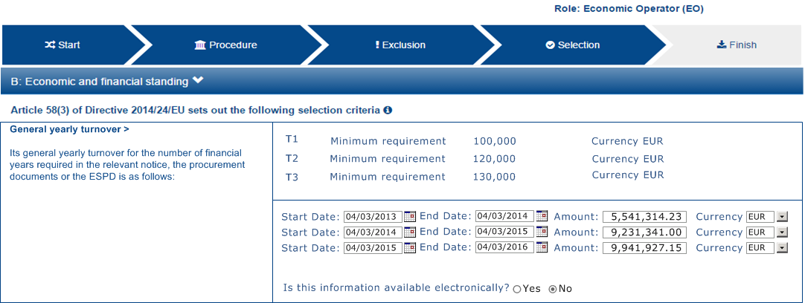
1
2
3

Slide 36
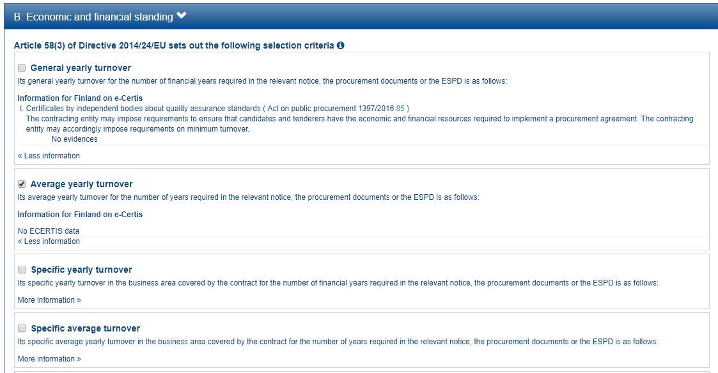
1
2
3

Slide 37
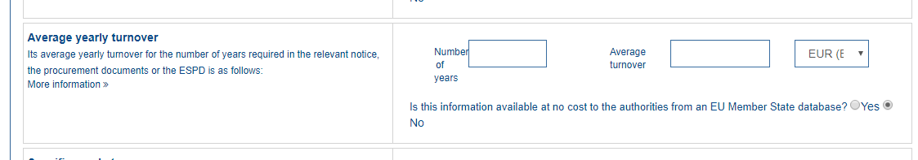

Slide 38
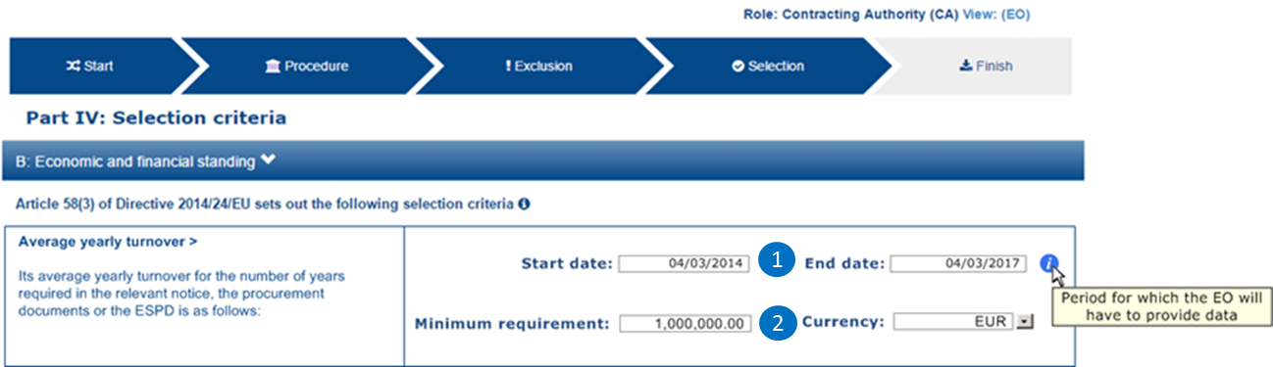

Slide 39
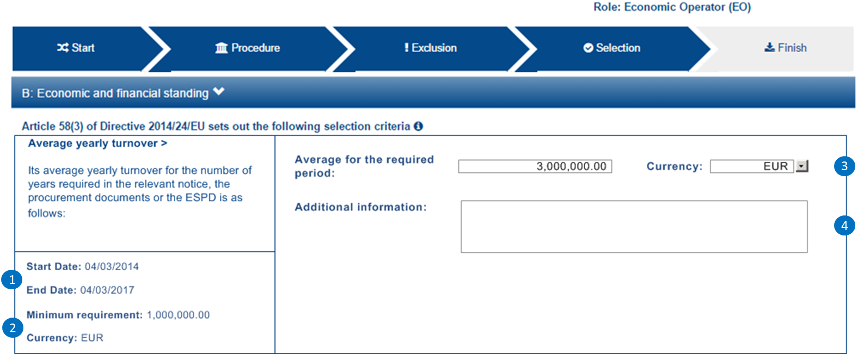

Slide 40
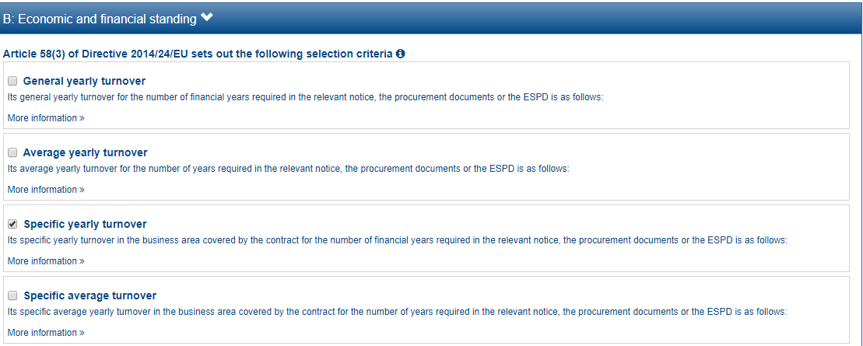

Slide 41
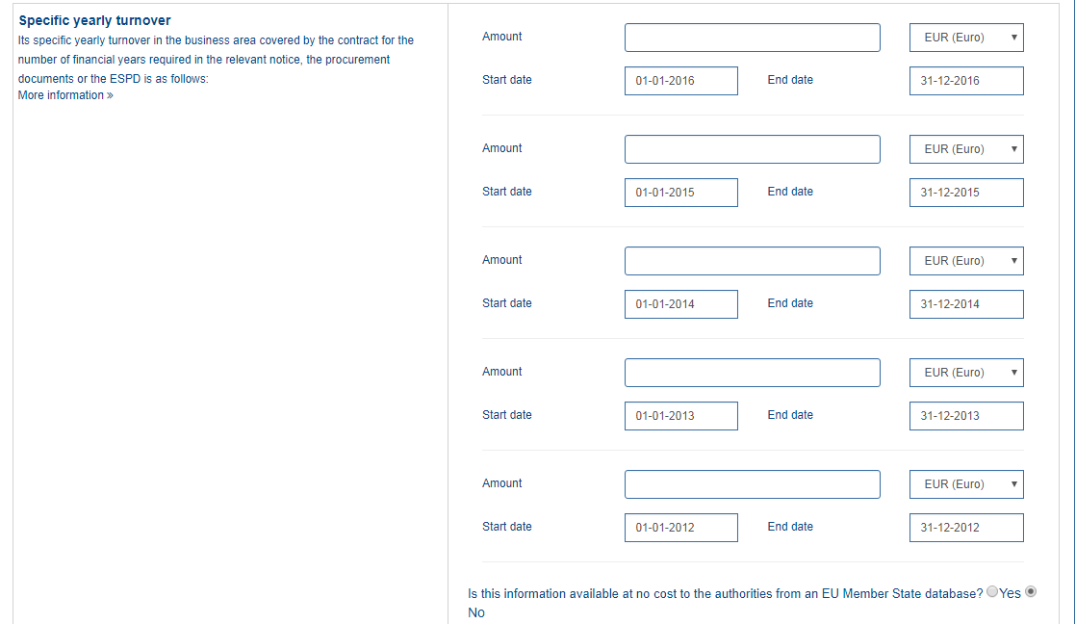
1
2
3
4
5
6
7
8
9
10
11

Slide 42
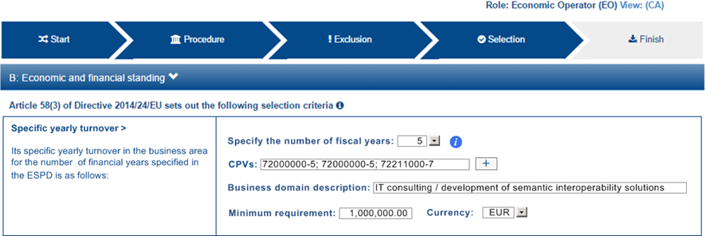
1
2
3
4

Slide 43
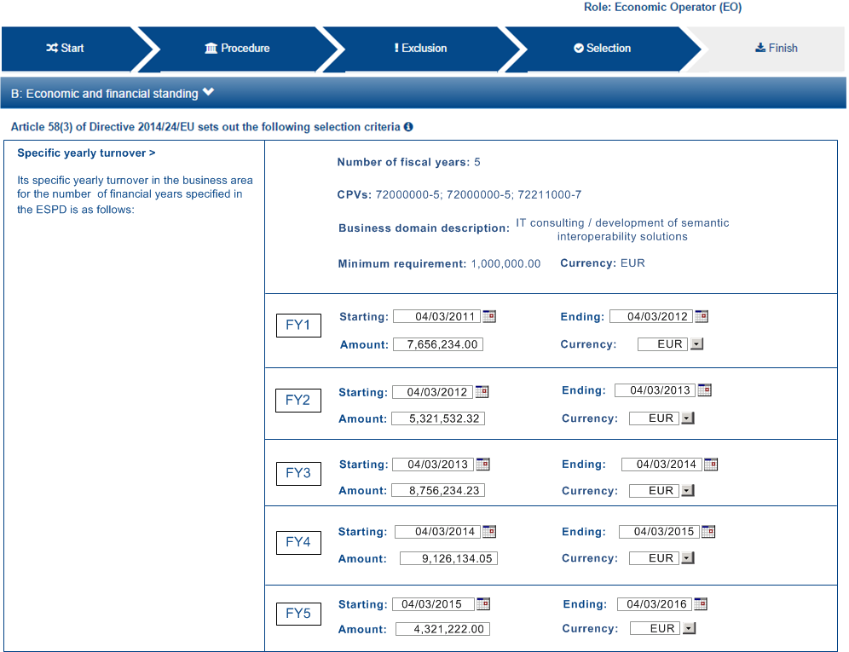
1
2
3
4
5
6
7
8
9
10
11
12
13
14

Slide 44
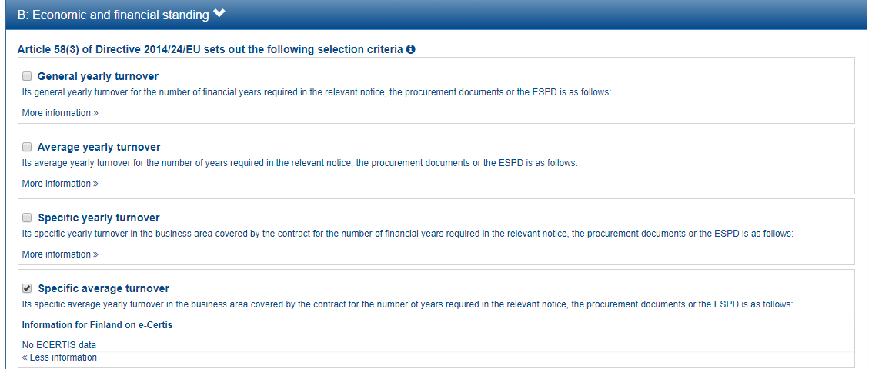

Slide 45
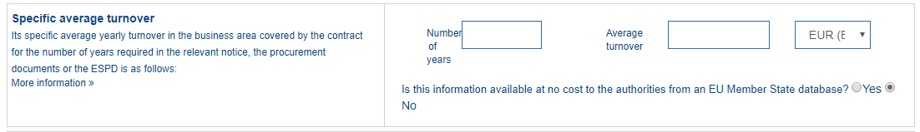
1
2
3

Slide 46
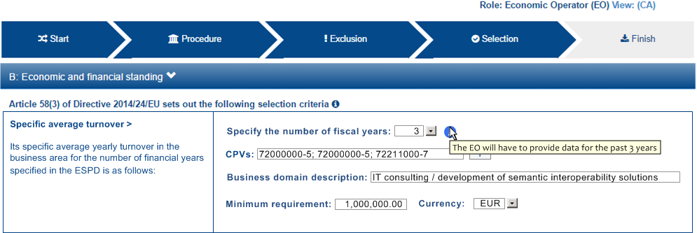
1
2
3
4

Slide 47
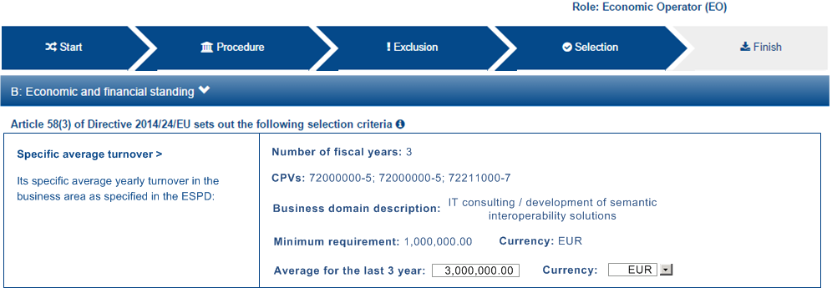
1
2
3
4
5

Slide 48
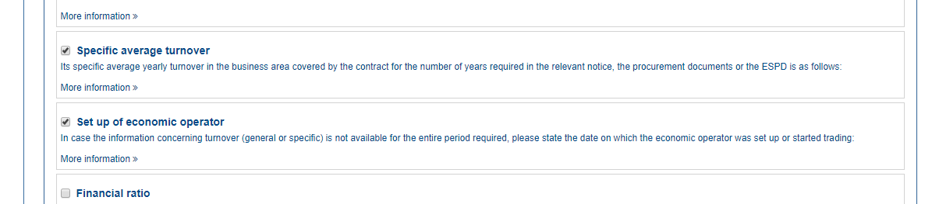

Slide 49
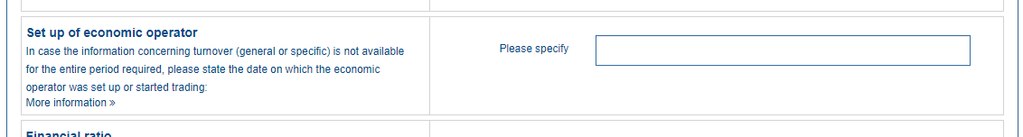
1

Slide 50
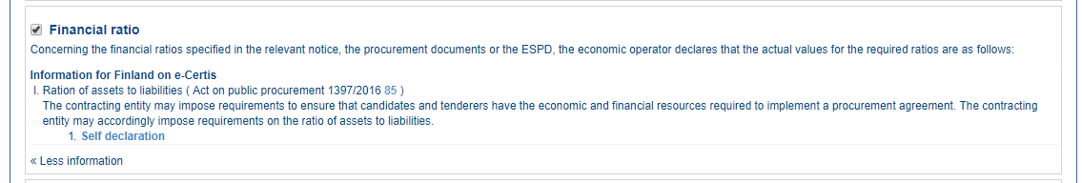

Slide 51
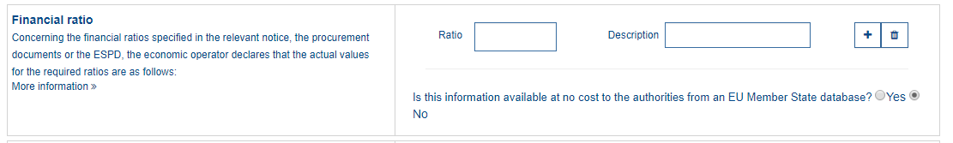
1
2

Slide 52
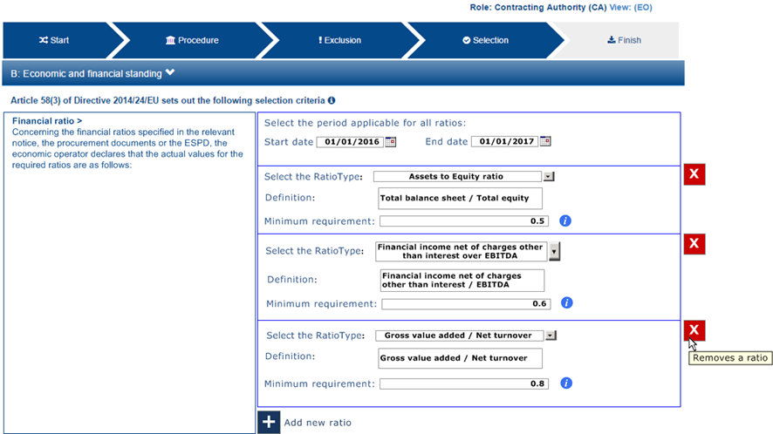
1
2
3
4
5
6
7
8
9
10

Slide 53
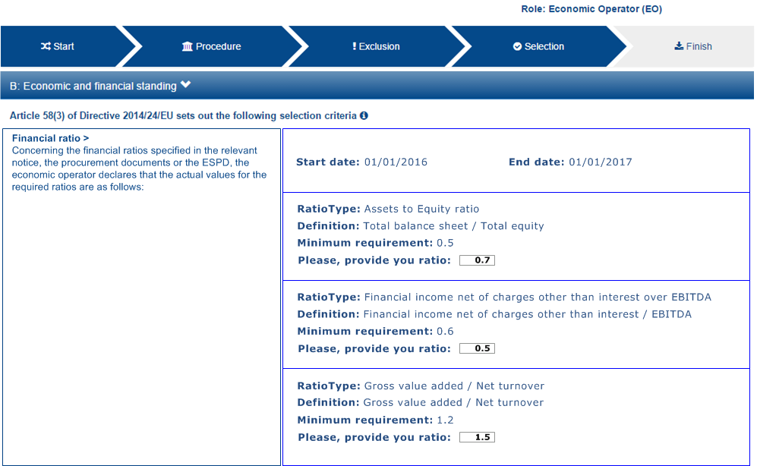

Slide 54
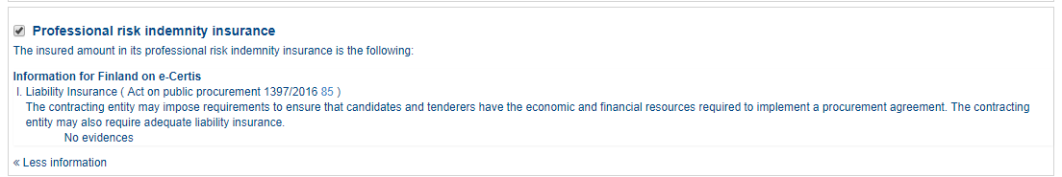

Slide 55
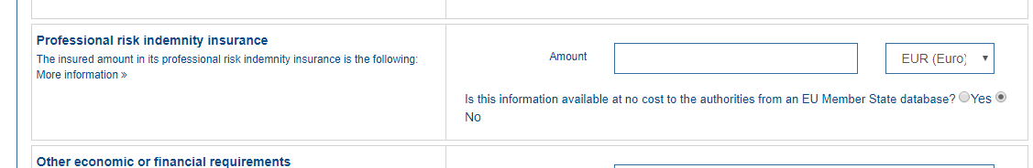
1

Slide 57

1
2

Slide 58

3
1
2

Slide 59

3
1
2
4
5

Slide 60


Slide 61

1

Slide 62

1
2
3
4
5
6
7
8

Slide 63

9
1
3
4
5

Slide 64


Slide 65

1
2
3
4

Slide 66

1
2

Slide 67

3
4
5
6
7
8
9
10
1
2

Slide 68


Slide 69

1
2

Slide 70

1

Slide 71

1
2
3
4
5
6
7
8
9
10
11

Slide 72


Slide 73

1

Slide 75

1

Slide 76

1
2

Slide 77


Slide 78

1
2
3
4

Slide 80

1
2

Slide 81

3
1
4
2
5

Slide 82


Slide 83


Slide 84


Slide 85

1
2

Slide 86

1

Slide 87

1
2
3
4
5

Slide 88
1
7
2
8
3
9
4
10
5
11
6
12
13
14
15
16
17
18
19

Slide 89
1
7
2
8
3
9
4
10
5
11
6
12
13
14
15
16
17
20
21
22
23
18
19

Slide 90
1
7
2
8
3
9
4
10
5
11
6
12
13
14
15
16
17
20
21
22
23
18
19
24

Slide 91
1
7
2
8
3
9
4
10
5
11
6
12
13
14
15
16
17
20
21
22
23
18
19
25
24
26
27
28

Slide 92


Slide 94


Slide 95


Slide 96


